Slide 1

THE DAILY DOSE OF CAFFEINE APPLICATION
Awaken me caffeine
Hananee Dalor 562431073

Slide 2
INTRODUCTION
The daily dose of caffeine application is a project that calculates the amount of caffeine contained in coffee, tea, and another drinks with ingredient based of cocoa and chocolate-based, and these beverages can be divided into three categories: hot, cold, frappe.
This application helps in managing projects in various fields, including record daily drinking data of users , informing and displaying information when users drink too much . Consumers or users will be more aware and more healthy

Slide 3
PROBLEM STATEMENT
Consumers are not aware of health issues.
There is an increase in coffee drinking every year, but consumer still lack knowledge of caffeine contained in beverages.
There is no application with the notification function showing the amount of caffeine that should be received.

Slide 4
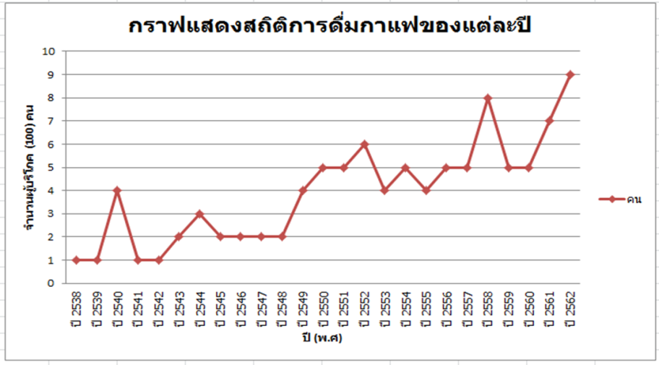
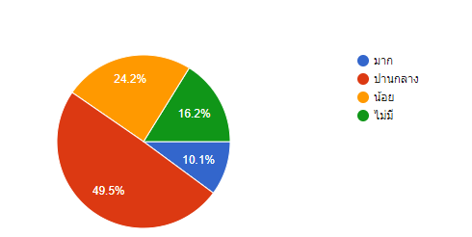
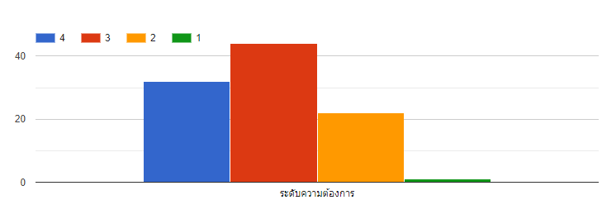
THE RESULTS FROM ONLINE QUESTIONNAIRE
ข้อมูลแสดงความรู้เรื่องคาเฟอีนของคนในพื้นที่
ข้อมูลแสดงความอยากรู้เรื่องปริมาณคาเฟอีนของแต่ละเครื่องดื่ม
Source:https://docs.google.com/forms/d/1QvzA7zjrQbw_DsmSzE0r5v-vzJFna5dp92cKyntNupo/edit#responses

Slide 5
OBJECTIVE
To develop calculate caffeine application of user or consumer who drink caffeine
To show symbol when consumer overdue.
To show graphs of drinkers and summarized as a daily, weekly and monthly graph.

Slide 6
PROJECT SCOPE
The proposed of this application was created for all consumer or user who drink beverage containing caffeine.
This application will calculate three types of beverages such as hot drinks, cold drinks and frappe drinks .
This application which will calculate from standard cup of drinks and specific the menu of coffee, tea menus and others drink which has ingredient of cocoa etc.

Slide 7
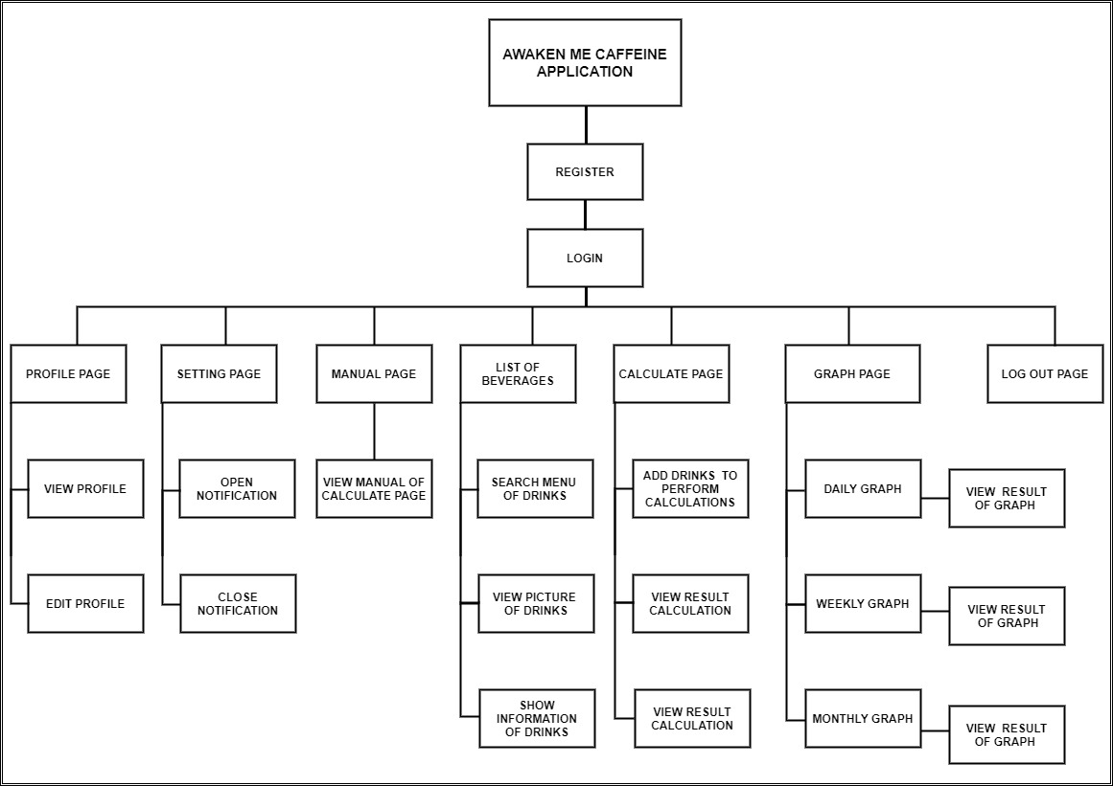
PROJECT STRUCTURE

Slide 8
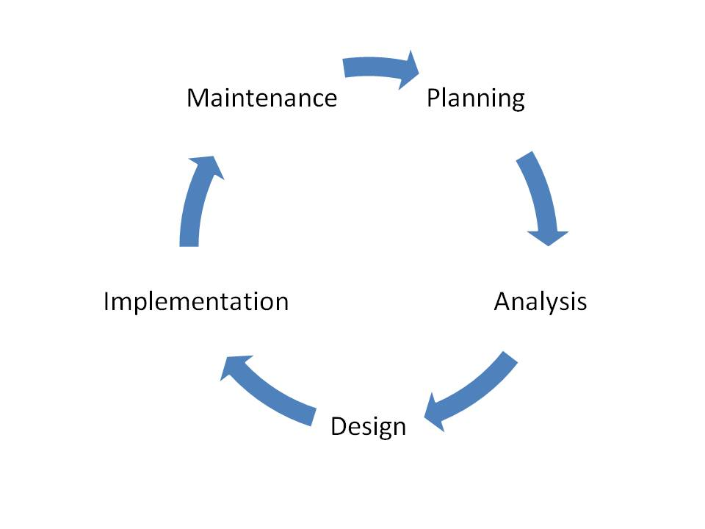
METHODOLOGY
The software development life cycle (SDLC)

